Slide 1


Alpha Phi Omega
Chi Chapter at UCLA
Alpha Mu / Kay Krenek Term, Meeting 3
October 29, 2014
www.apo-x.org

Slide 2
Agenda
1. Pledge Class 4-Part Harmony Toast Song
2. Officer Updates and Announcements
3. Chapter Business
4. AM Budget Approval
5. Last Announcements

Slide 3
President
Raymond Mai
president@apo-x.org
Executive Committee
excomm@apo-x.org

Slide 4
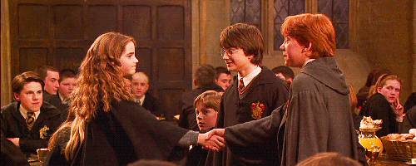
Respect Among Brothers
We are a Brotherhood. We are Brothers.
As much as we have reservations about each other, we are all here for a Sacred Purpose: Service.
Let us take maximize our opportunity to give back in order to build strong camaraderie and unity
Any perfectly functioning organization will falter at times, but it is how we pick ourselves up that demonstrate character.

Slide 5
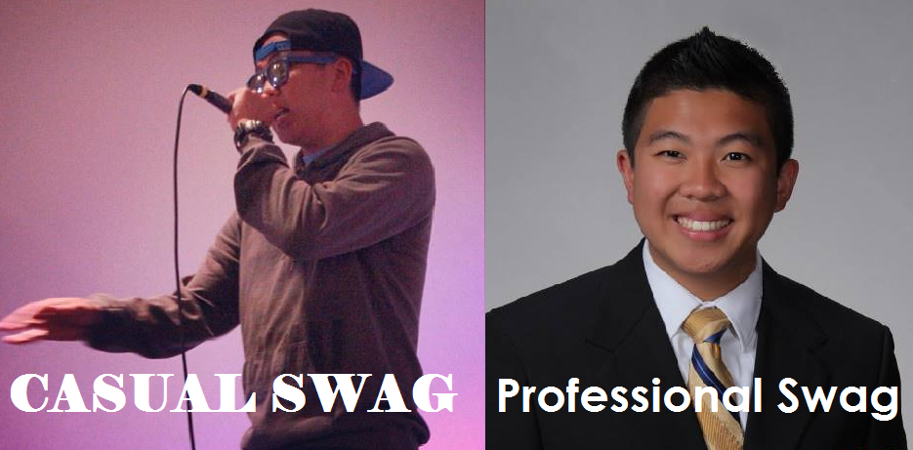
Leadership Workshops
I will be putting on my term tradition, career development workshop, “I Mean Business”, which helps you with resumes, cover letters, interviews, and networking
I’ll help you know the difference between:

Slide 6
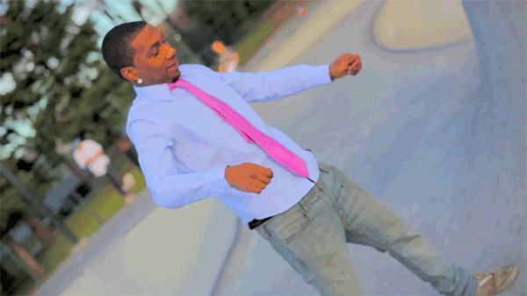
Leadership Workshops
If you want to put on a workshop, come talk to me!
We should embrace the diversity in our chapter, and you should help teach and showcase something that you think the chapter will benefit from!

Slide 7

Mental Health Awareness
CAPS (Counseling And Psychological Services)
West side of Wooden Center
Operating Hours 8am-8pm (Mon-Thu), 9am-5pm (Fri)

Slide 8

Mental Health Awareness
Look at the people to your left and right
Would be willing to talk to them about personal issues
If so or if not, then why?
As a Brotherhood, we have a high standard to look out for each other.

Slide 9
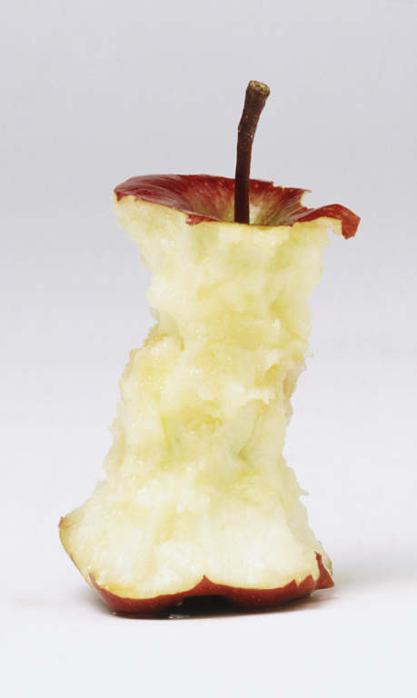
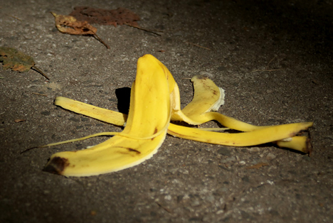

Lastly...
Look at that Apple
Look at that Banana peel
No one should clean it up but you!
Brothers and Pledges, PLEASE PICK UP YOUR TRASH AFTER MEETINGS!

Slide 10
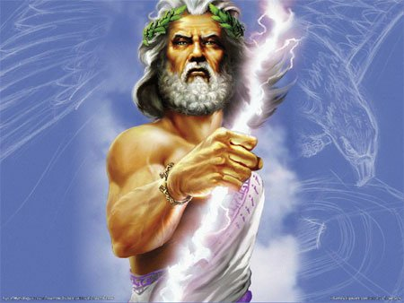
Lastly...
Don’t have side conversations during toast song please
The APO Gods will NOT be happy if you do it again

Slide 11
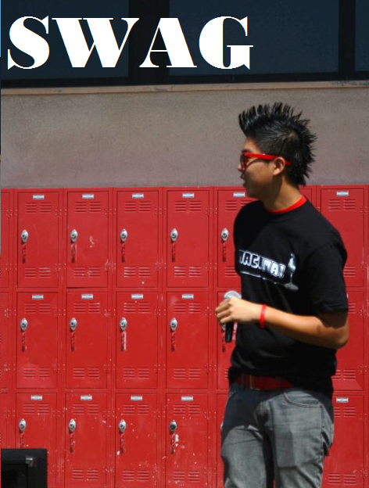
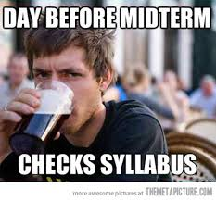
HAVE A SWAG WEEK.
GOOD LUCK ON MIDTERMS!

Slide 12
Administrative VPs
Kevin Quizon & Nicola Yip
admin@apo-x.org

Slide 13
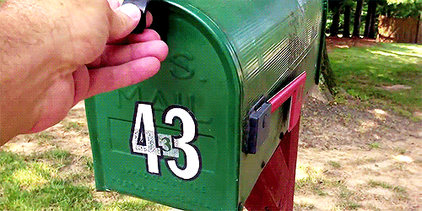
New Mailbox Address
10920 Wilshire Blvd., Suite 150-9220 Los Angeles, CA 90024-6502

Slide 14
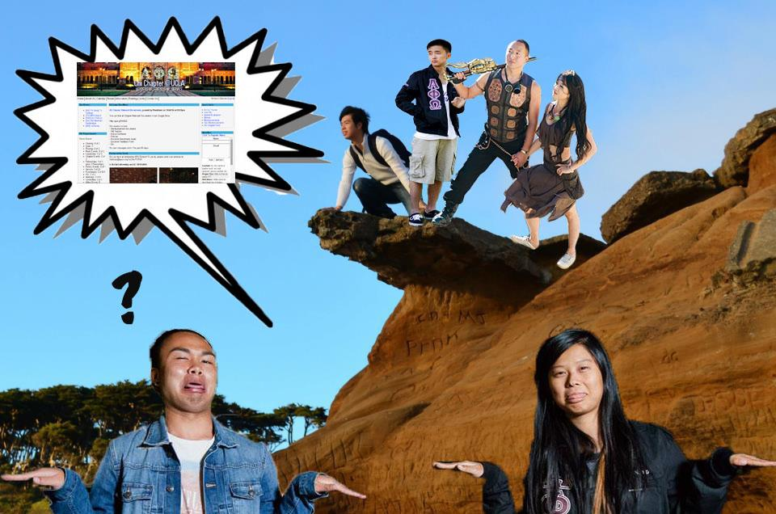
Website is Up!
Thank you for your patience!
Sign up for events :)
Special Thanks to Geoffrey Lee!

Slide 15
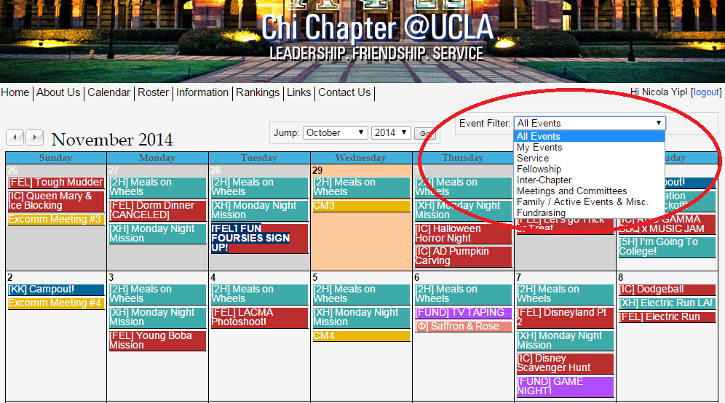

Slide 16
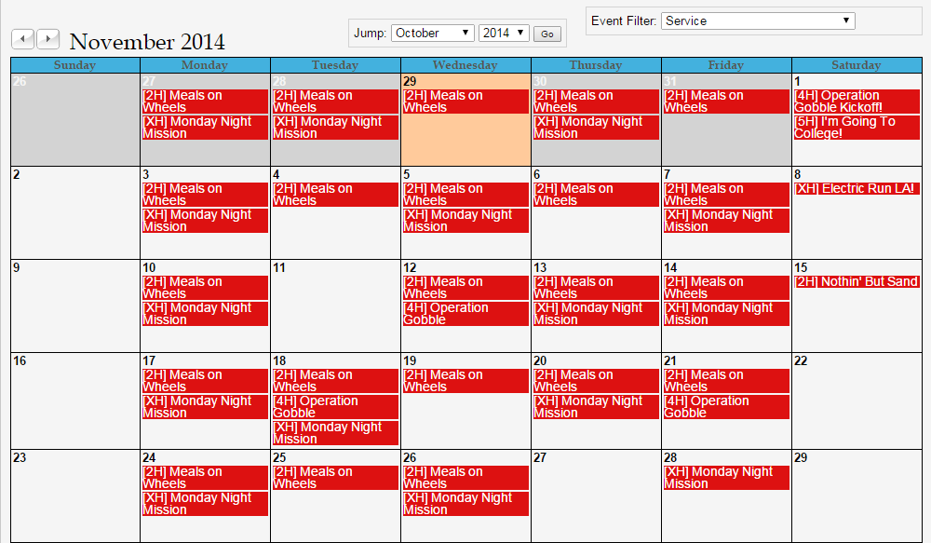

Slide 17
MEMBERSHIP.
Jeremy Gozzip & Andrew Suh
membership@apo-x.org

Slide 18
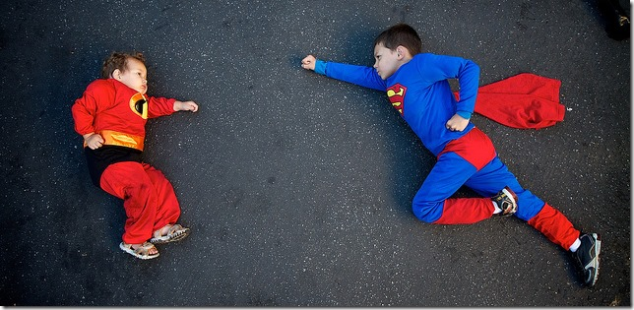
THIS TERM’s THEME: Superheroes

Slide 19
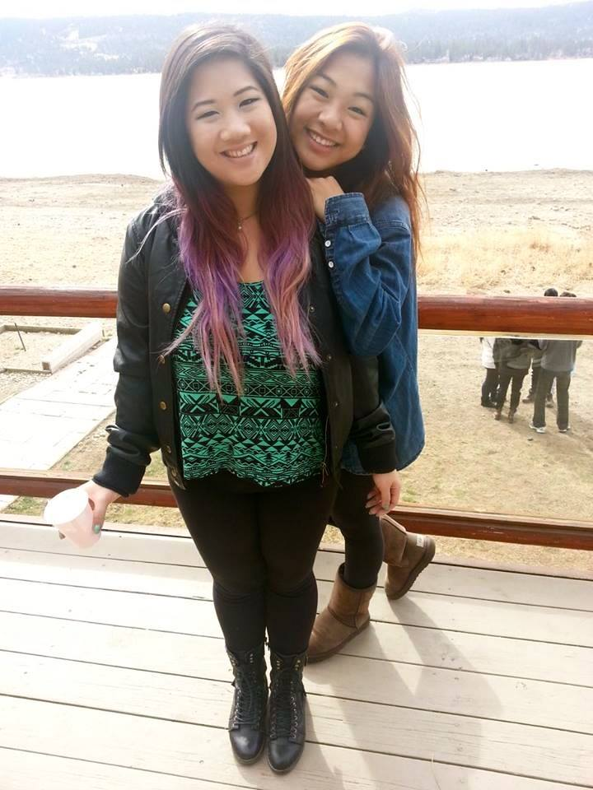
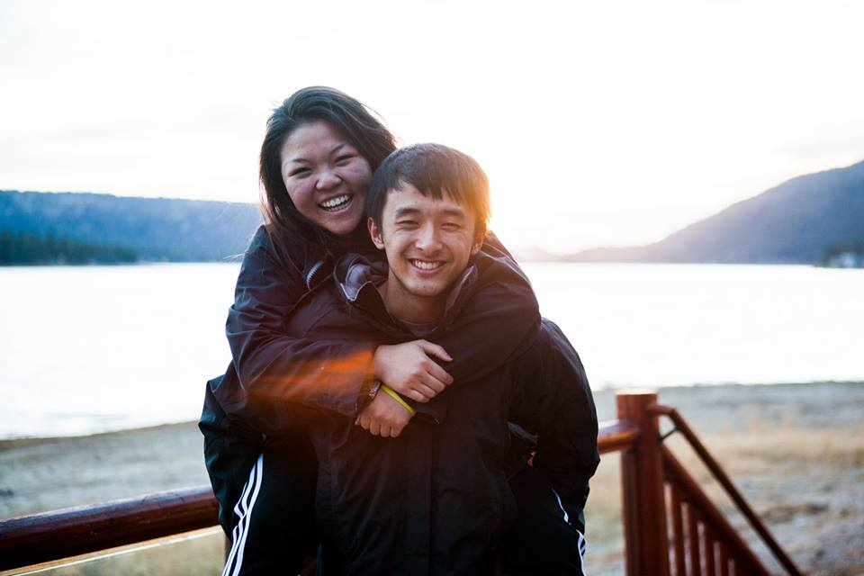
Ski Trip
Diane Huynh! Joseph Chan!

Slide 20
Ski Trip
Winter Quarter Weekend of Week 1
Friday 1/9 - Sunday 1/11?
-$60/Person
Blue Moon Lodge (same as last year)
-2day/2night, 5 meals provided
-share beds & bring sleeping bags

Slide 21

Campout~
Drivers list will be sent out Thursday night!
Let us know of any changes
if you are signed up!

Slide 22
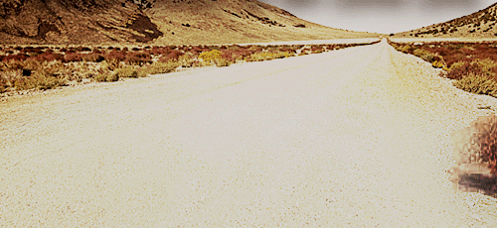

Slide 23

Where dem Twinz @?
Hope you all dressed up for today’s spirit day :)

Slide 24

Superhero Charades!
Spirit Committee comes up to act it out and whole active body gets to guess.
The family that
guesses most out of
the list wins! (1min)
errrbody be like.

Slide 25
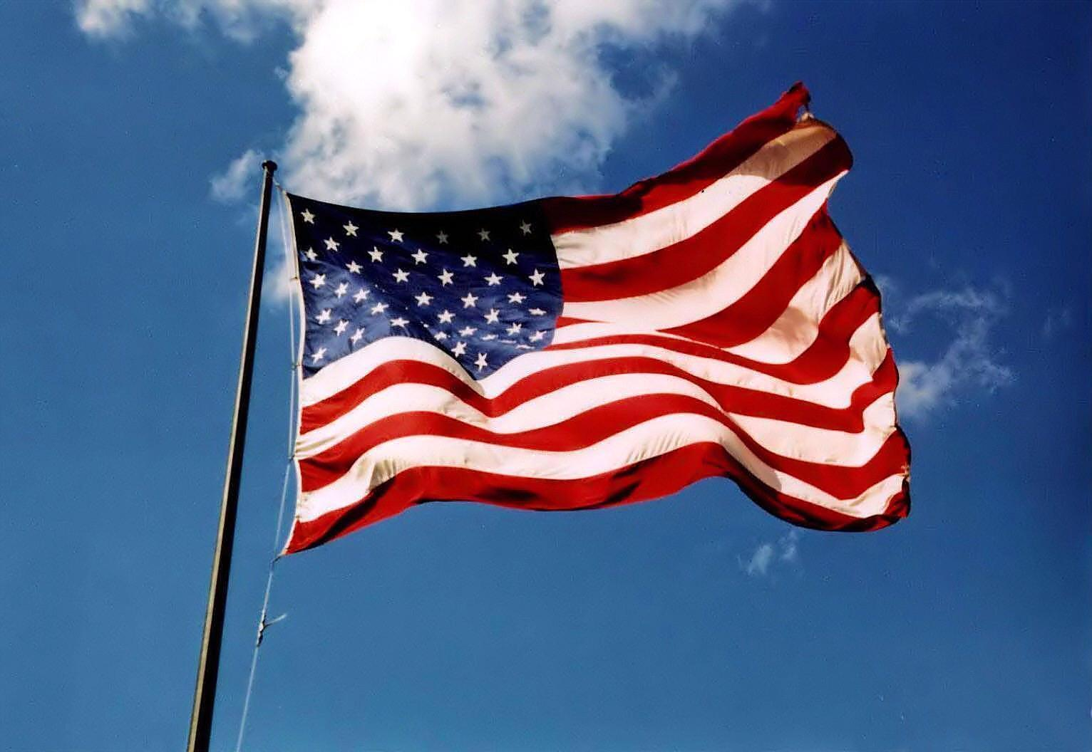
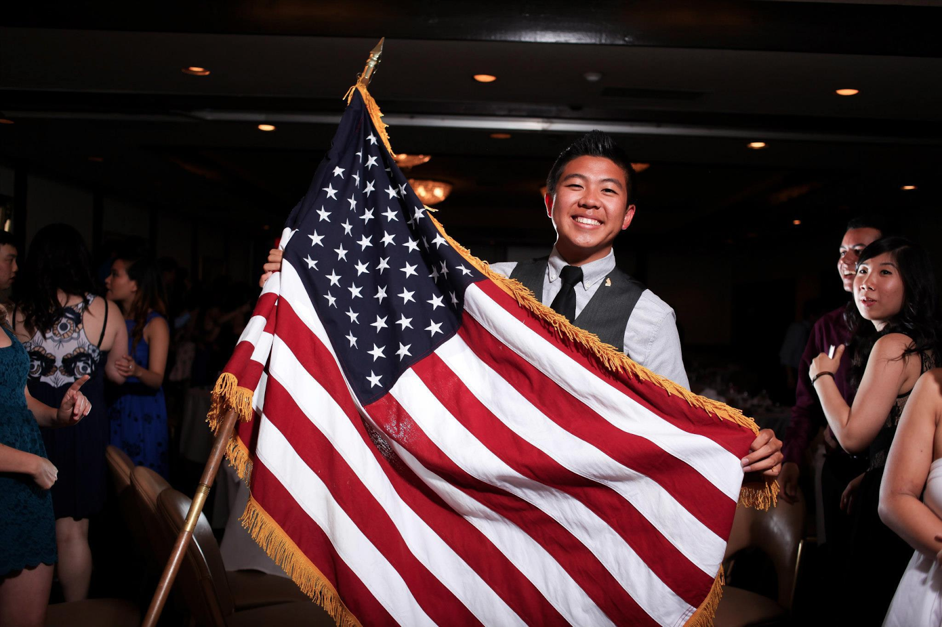
Next Weeks Theme…...
AMurika~

Slide 26
Service VP
Rui Guo
apoxservice@gmail.com

Slide 27
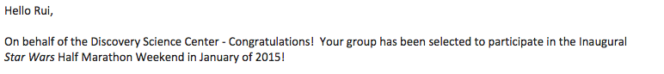

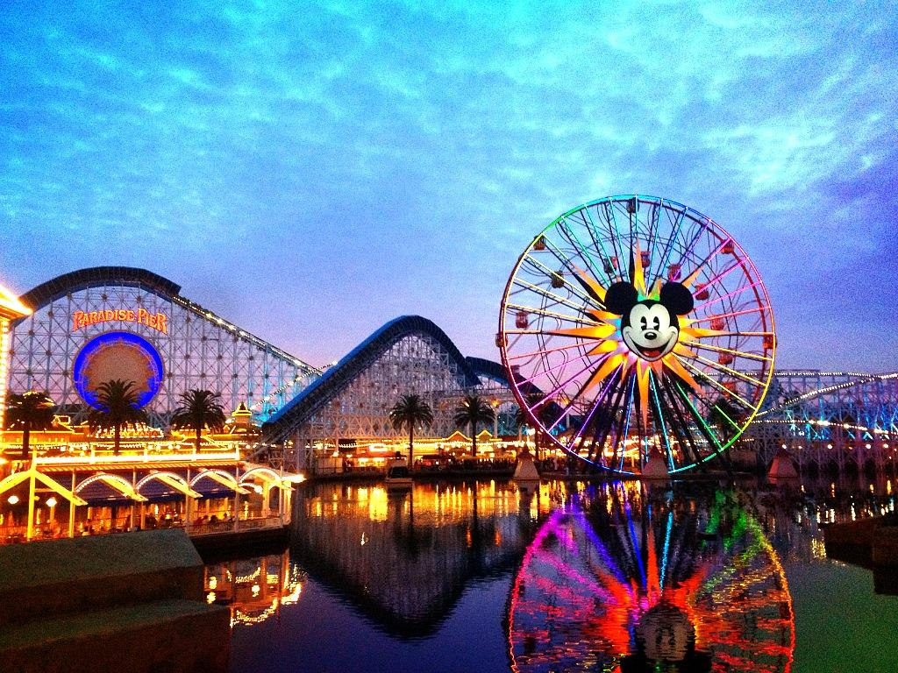
Disneyland January 16!
50 volunteers required to register by November 21
BUT THE MORE THE MERRIER!

Slide 28
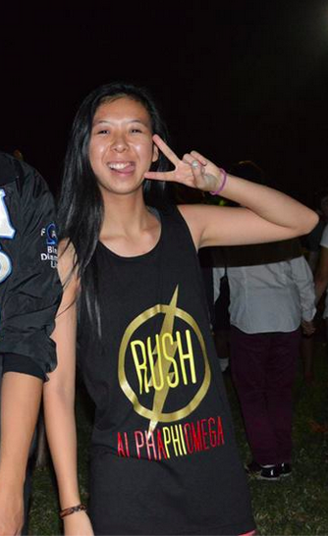
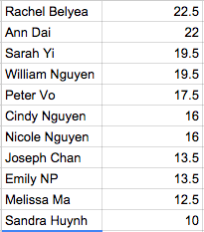
Service Leaders!
Tracker is updated! SHOUTOUT TO JENNY LAM
Congrats on finishing the first milestone achievement!
FILL OUT THOSE EVALS!

Slide 29
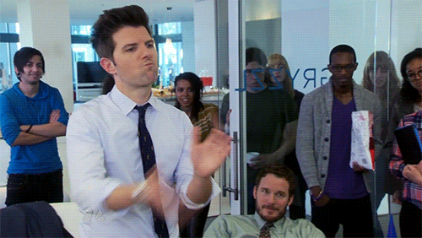
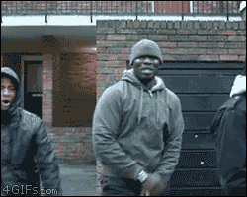
Upcoming Events
New events are up! Check the calendar!!

Slide 30

Pledge Parents
Brian Lee & Emily Neai-Proeung
apoxpparents@gmail.com

Slide 31

Toast-Song 4-part Harmony!

Slide 32
Assignments
20 Actives
PIFs - Extra SWIMMINGLY
Mission: Music Video (due PM#5 Nov. 12)
Quiz: Chairing Guidelines, Values, Fraternity Symbols/Objectives

Slide 33
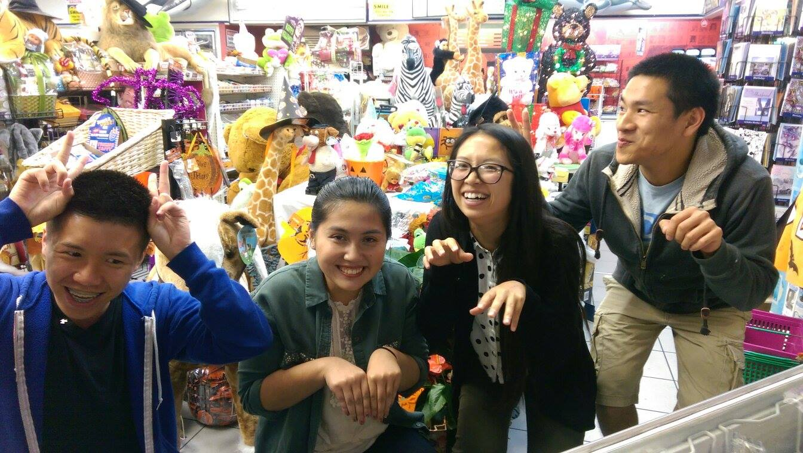
Pledge interview Fellowships

Slide 34
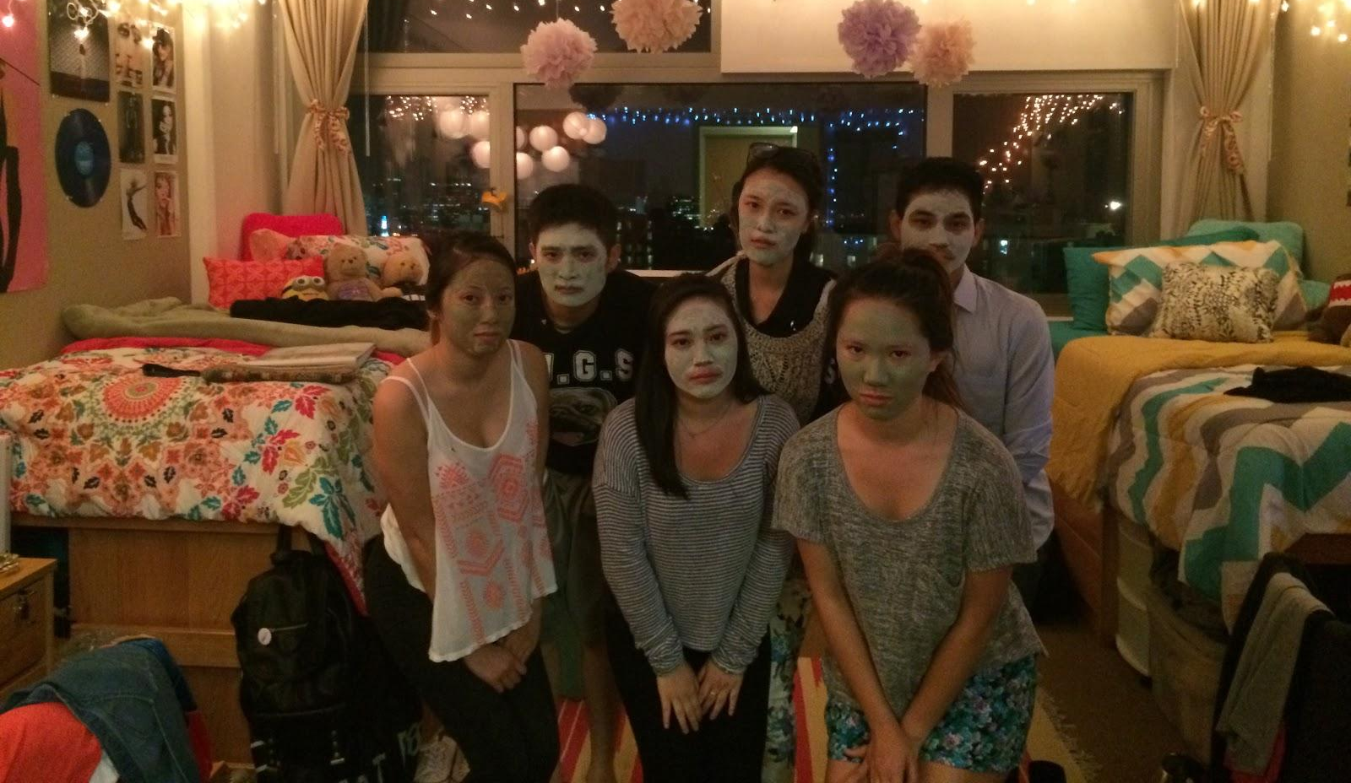
Pledge interview Fellowships

Slide 35

Campout is this weekend!
Please let us know if you can
come up Friday :)
We’d always appreciate more Active company!
Any camping supplies to lend for the weekend? Please let us know too!

Slide 36

Be prepared for Halloween funsies!
Bring a costume! :^)

Slide 37
Finance VPs
San Li & Jonathan Liu
finance@apo-x.org

Slide 38
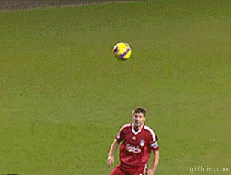
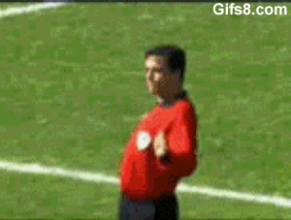
Dues!
Actives please pay JT after meeting! (cash or cheque only!)
Pledges on the PP: $20 next week!

Slide 39
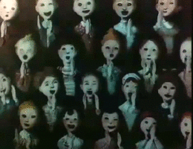
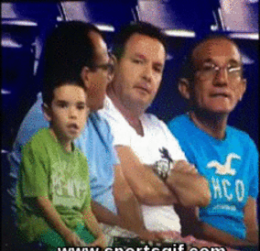
Fundraisers
TV Tapings - 5 people minimum
11/6 - Cristela (Bussable!)
11/11 - The Odd Couple
Starring Matthew Perry
11/25 - The Millers
*Payouts normally range from $15-$25
Mo people = mo money

Slide 40
Fellowship VPs
Ann Dai & Danny Ly
fellowship@apo-x.org

Slide 41
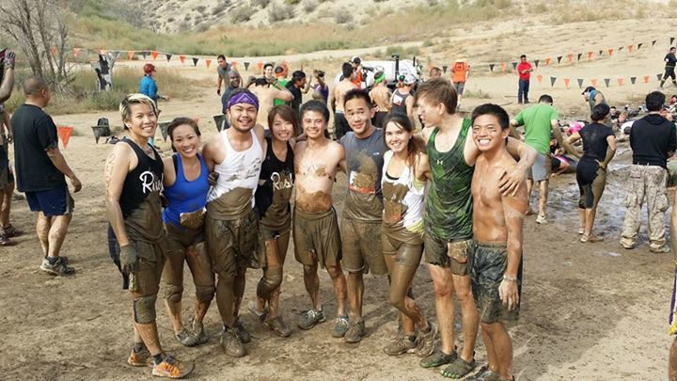
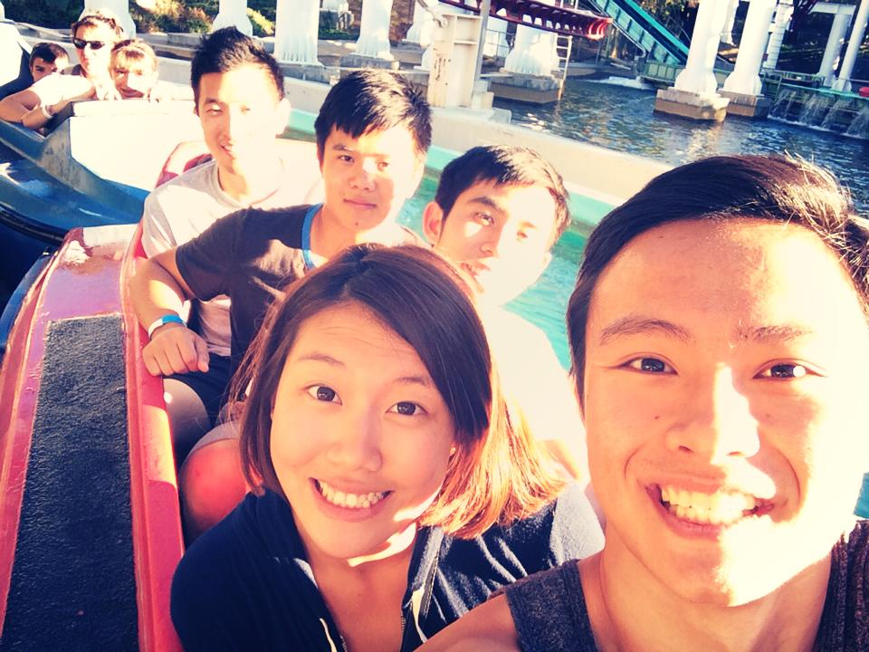
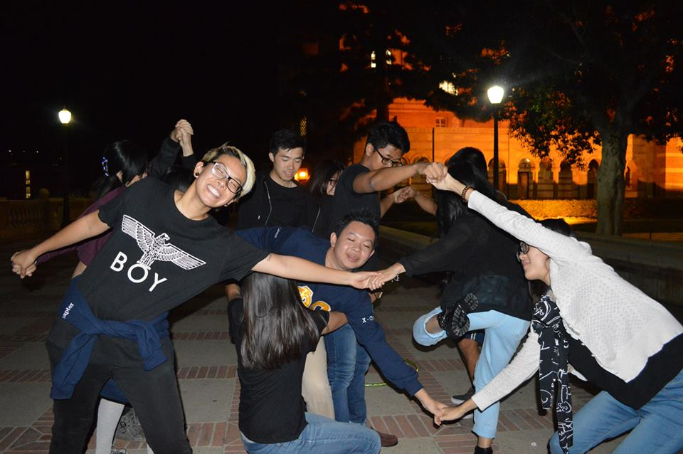
Thanks for coming out!!
Meet the Pledges
Six Flags
Game Night
Tough Mudder
IM Volleyball

Slide 42
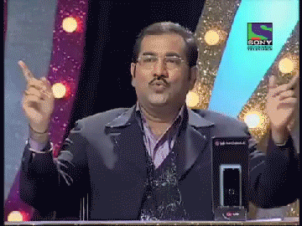
new fellowships
Young Boba Mission 11/3
LACMA Photoshoot 11/4
Disneyland 11/7
Basketball 11/11
Laser Tag! 11/15
Karaoke Night 11/10
Cafe Study 11/17
Looking Good Night 11/14

Slide 43

Looking Good Night Info
11/14 Friday 6:30 pm
Empress Harbor Seafood Restaurant
Price: $22 Dollars for everyone!
Please pay Lucy Diep, Melissa Ma, Joanne Kung, John Young, Nicole Nguyen, or Peter Vo
Payment is due 11/12!!!!!!
After it will be $24 per person.
Event is on the calendar now!!!!!

Slide 44

LGN mEALS Menu
7 Entrees + 1 Soup + 1 Dessert
Barbecued Fried Rice, Pineapple with Fried Shrimp Balls
Sugar and Black Pepper Beef, Hong Kong-flavour Short rib chop
Steam Rock Cod with Vegetables, Fried Crispy Chicken,
Seasonal Vegetables with Garlic sauce, Seafood Tofu Soup
Chinese Special Dessert
The restaurant also provide Vegetarian Menu!
Also, will make sure they have gluten free meals!

Slide 45
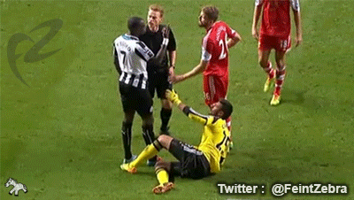
ball game
10/29 TONIGHT!!! 10:00pm IM Volleyball
SAC 2nd Floor
11/05 Wed 10:00 pm IM Volleyball
SAC 2nd Floor
11/06 Thur 7:45 pm IM Soccer
Wooden Court #1

Slide 46

Sign Up Sheet
FunFoursies
(Pledges can sign up too!)
LGN Talent Show
Can also sign up online later!!

Slide 47

Historian
Juana Li
historian@apo-x.org

Slide 48
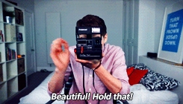
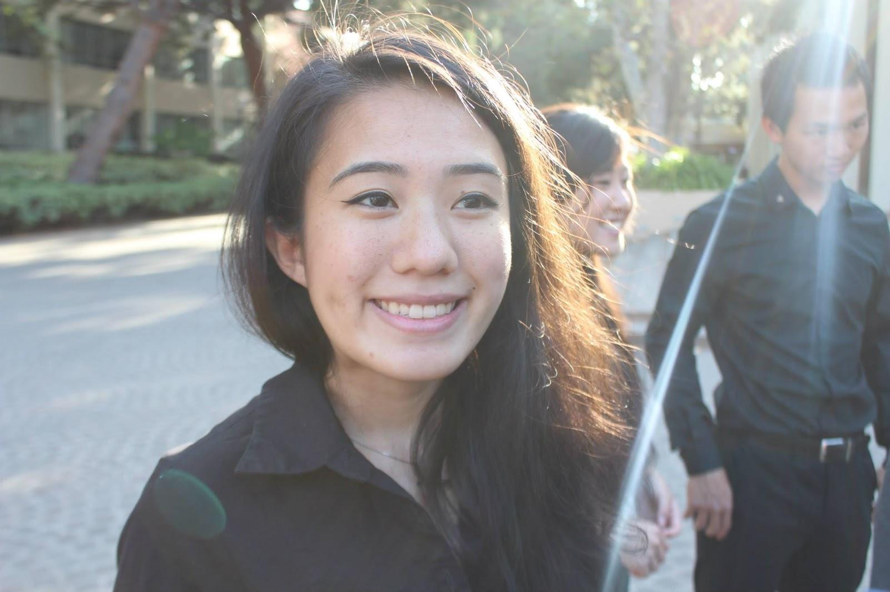
Updates
Take your headshot photo after meeting today if possible!
Keep sending me nominations for BOTW or you can also send them to Iris :)
Look out for Brothers of chi chapter photos on Facebook!
Webisode #2 Coming next week..yeee such excites!

Slide 49
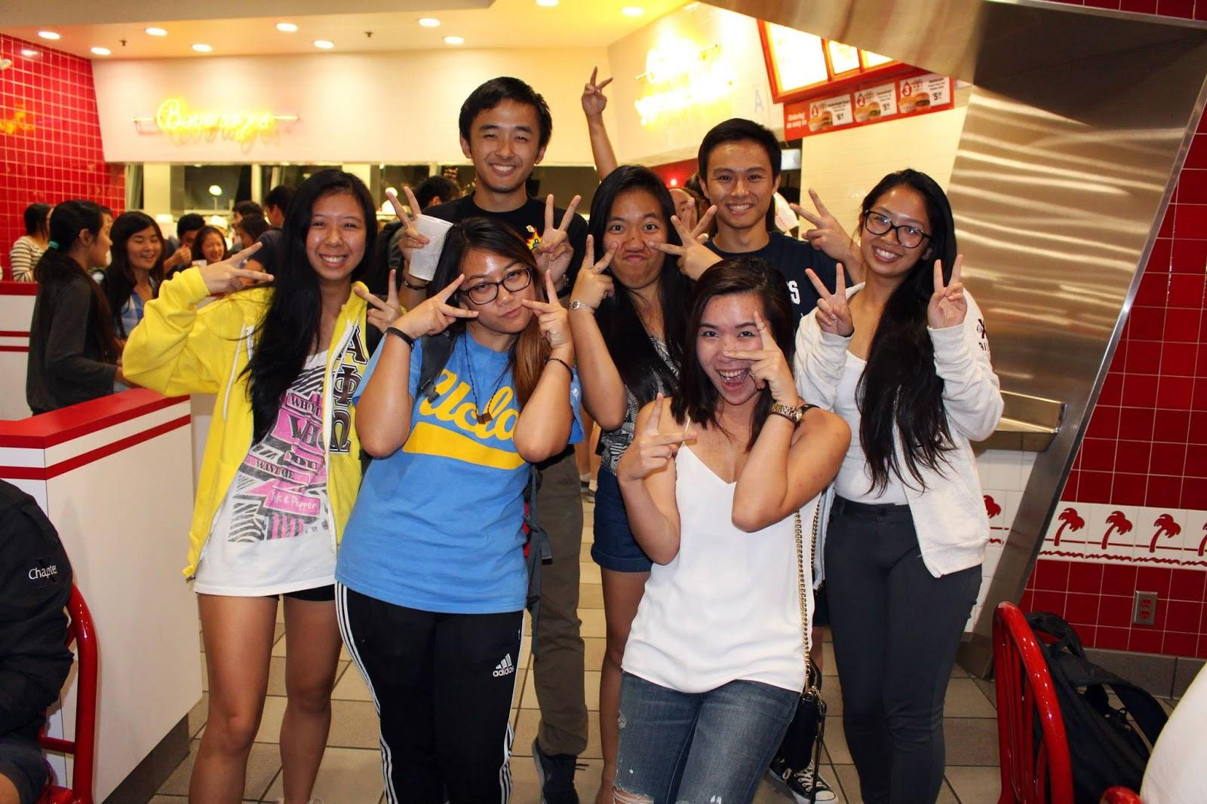
Brother of the Week

Slide 50
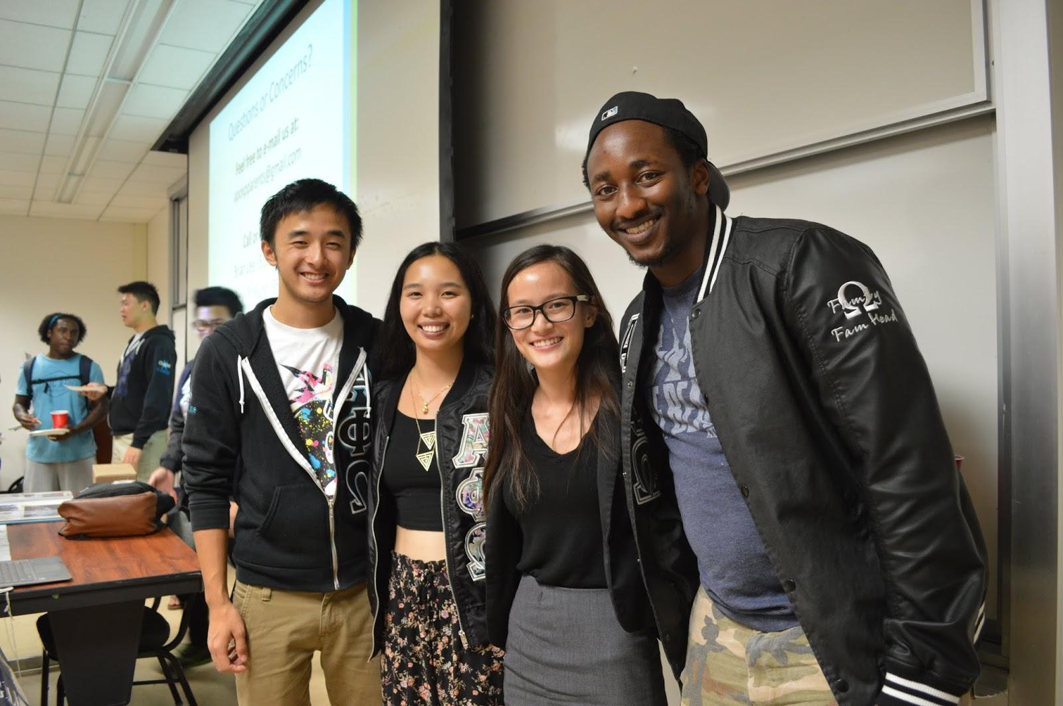

Slide 51
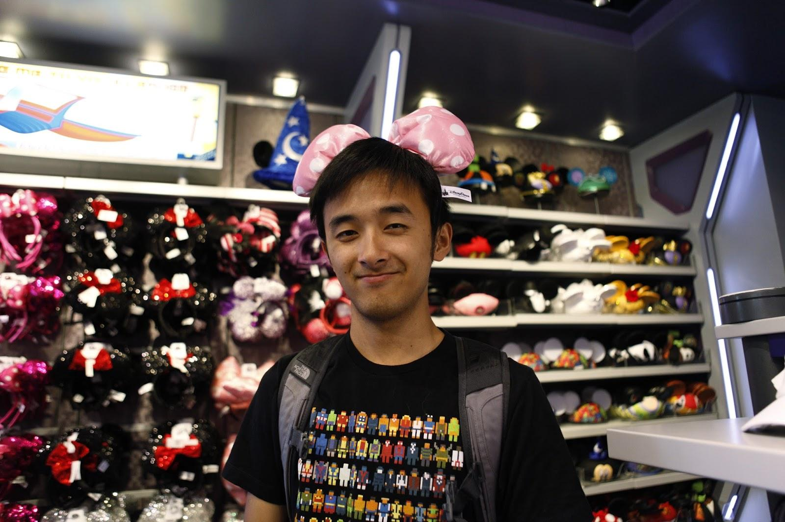
The Young Joseph Chan

Slide 52
Sergeant-at-Arms
Josh Chin
apoxsergeant@gmail.com

Slide 53

Announcements
Dual chairing: In the reminder e-mail, say who is chairing! ~ Sincerely, …
People who need pins TODAY ~ see me immediately
Reminder that 5 minutes after the gavel is pounded, is when you are considered late

Slide 54

ABEA
ABEA = America’s Best Evaluation Award
And the winner is...

Slide 55
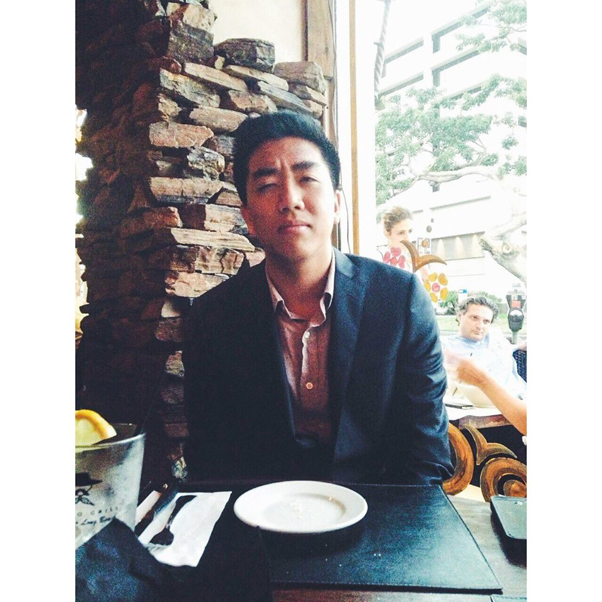

WILLIAM NGUYEN
yayyyyyyy :)

Slide 56
Color Run
We were a little concerned because some people weren't exactly sure if they received a confirmation e-mail or not but we went regardless. We arrived a little late thanks to, strangely, traffic, at 7:07 AM and coincidentally parked right next to each other. We then walked to the volunteer booth and were one of the last groups to be assigned jobs. Since we weren't one of the first groups they split our group in half: Peter, Sarah, Rachel and Kim went to the start line of the race and helped out there while William, Emily, Abelard, Nicole, and Sandra helped out at the information booths. At the info booths we mostly helped open boxes and refill boxes with t-shirts of various sizes. The merchandise they had was really high quality and so were the shirts! I think they were American Apparel or similar, cause the shirts were so soft.After cutting open boxes, handing out t-shirts and breaking down unused boxes, we helped pass out goodie bags to the participants to finish off registration. The person in charge then thanked us for our hard work by essentially telling us to help ourselves to any merchandise (WOOOO FREE T SHIRTS) and told us to chill for a bit. We then went back to the car to drop off our haul and ran into another coordinator at the start line of the race, who challenged us to get through the race in 57 minutes. Abelard and Sandra were pumped up but Nicole was... not wearing the correct clothing and I... don't exercise and Emily wanted to make sure we were okay so we went at a somewhat slow pace through the race. We discovered that the race track is more of an open space area with multiple different sceneries such as a grassland and forest area as well as a (seemingly, according to the smell) fully functional farm (complete with a petting zoo) and massive unused parking space (seriously, they crammed all of us into one parking lot so trying to find the car earlier took a good 20 minutes). Whilst enjoying the scenery the bitchy other volunteers from high school clubs (seriously, they were all like 17 or something) repeatedly ignored our pleas to avoid the dust and attacked us anyways... despite it SPECIFICALLY saying to NOT hit anyone with dust if they say no... whatever. They had bad hair lines anyways and obviously aren't going anywhere in life with that shoddy foundation job that DID NOT match their skin tones. Meanwhile, Peter and crew walked from the start area where they were to the festival, where participants had finished the race and were given colored dust to throw into the air (and at each other) which was apparently a fun time. Sarah was concerned about her (expensive) free runs and did not want to get them dirty, so she wore plastic bags over her shoes (#ratchet). I hope we didn't scare Kim too much with how weird we are… Abelard and co then finished the race (Nicole and I were exhaustedly waiting at the finish line while Abelard and co ran around the actual race track... because fuck the sun and heat and stuff... also there's NO shade like at all... wow). We then proceeded to the finish line to take a picture then walked back to the start line to help disassemble things, where we met up with Peter and co and the 9AM shift which arrived to help out. After helping disassemble inflatable gates, flags, metal fences and rolling up any additional cloth, the coordinator called us over to thank all of us (because we actually STAYED the whole time and helped out... unlike the High school kids which he described as a "nightmare"... whatever). He then directed us to the field where we helped disassemble any other miscellaneous items. Once we finished with that we took a picture as a large group, sang the toast song and left the 9AM shift (since they would be there until 3PM). Overall the event was incredibly fun and I would recommend all people to do it. For future reference, the volunteer coordinators didn't even check if we were registered; we showed up and they simply assigned us locations and jobs, which were pretty ad-hoc. If people would like to flake in, it would most likely be possible, but I suggest showing up much earlier than when we did so they have a much more likely chance of being grouped together and given actual tasks instead of being given random jobs. The coordinators are really nice and really look out for your own benefit and health and are really grateful for your help, but they continually mentioned to form a group next time (which in the past has not been successful). I suggest calling the coordinators to ask for a step by step instruction process.

Slide 57
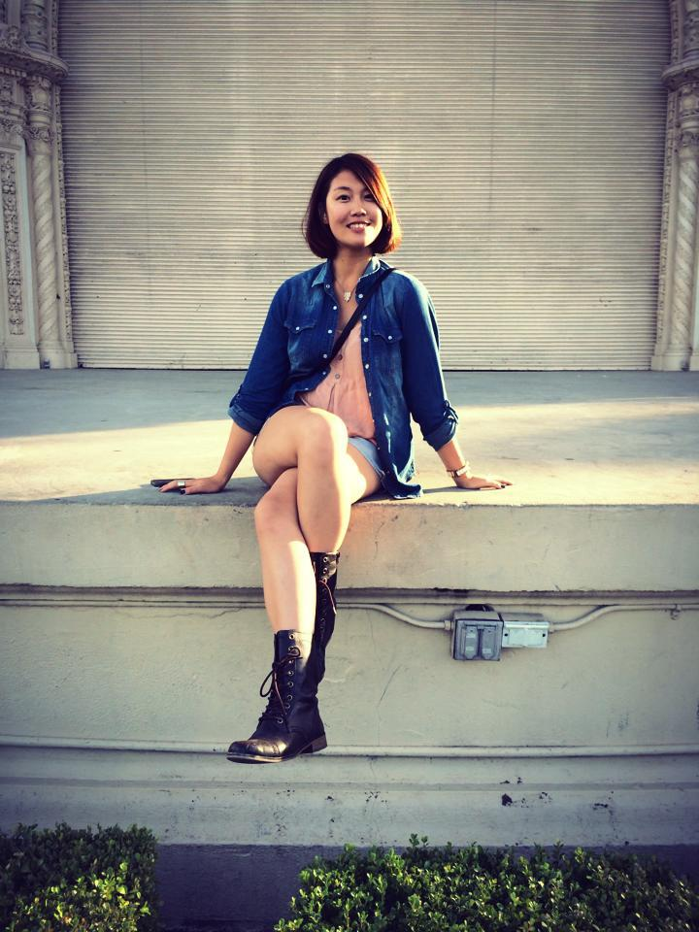

ANN DAI

Slide 58
Enrich LA
To be honest, I was not gonna do this service event because I still remember the pain last week. It was a long day and I even got sun burn last time. However, the color run was full and I could not go. Since I stayed in LA for the weekend so I wanted to do something instead of sleeping. I registered online and I was worried that they would not prove my application. However, the lady knew me already an she sent me back the mail around 6 a.m. I woke up and drove to the elementary school. I didn't see any volunteered I met last time. They must be exhausted after the events so never wanted go sign up again. I clean the plants again and also help other volunteers since it was their first time. Since it's my second time, I know what to do so it became easier for me. Also, this elementary school had a lot trees so I would not be under the sun. It is a great thing. The lady asked me to set up the water system. It was a new thing for me because I didn't do it last time. It was fun because we needed to measure how long the tube we need and cut it. It's easy but a lot works. I enjoyed the time there. They also bought donuts and other food for us. Since I needed to eat with my friends after the service. I didn't stay to have lunch with them. I remembered I said that I would not do enrich LA again because it's too exhausted. But here I came. I'm so glad I came here because even I'm tired but I really did have a good time work with other high school students!

Slide 59
Interchapter Chair
Chanel Ng
interchapter@apo-x.org

Slide 60
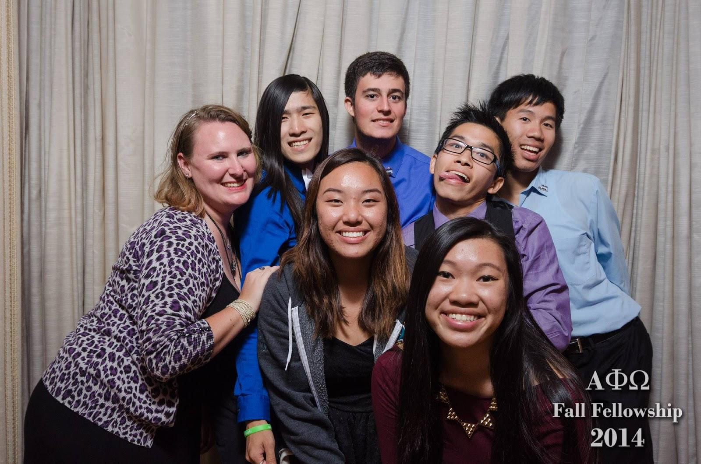
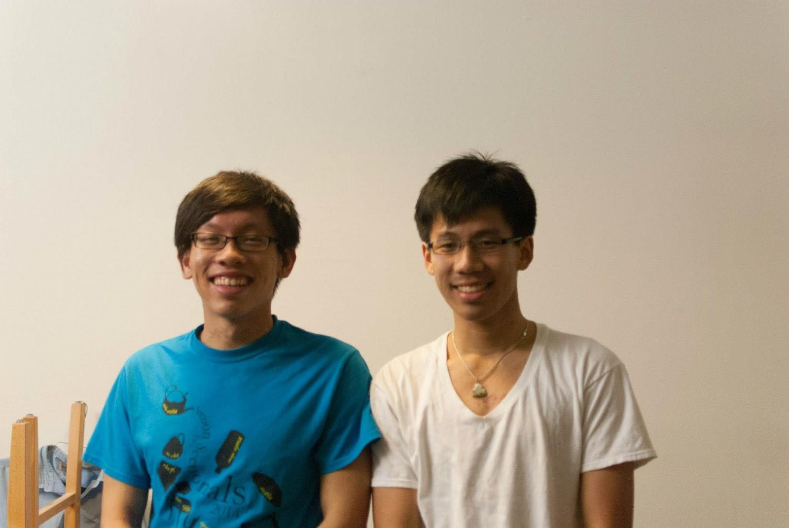
Fall Fellowship
Please welcome Bowen Lu~

Slide 61
Nationals
National Convention: December 27-30
Registration due by November 6th
$170 package deal + $89 room (split between 4) + plane ticket (~$400)
Fundraising option

Slide 62
Calendar Updated
Whoo~ check out the events up on the calendar. More GBMs to come.
Also sign up for Powderpuff!

Slide 63
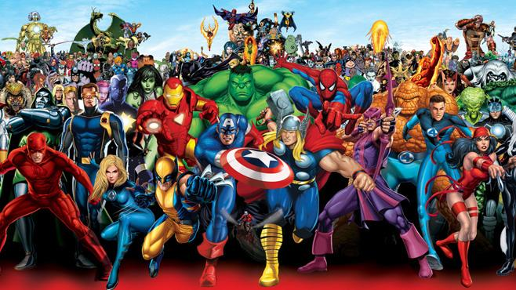
CAC
Paul Choung
cac@apo-x.org

Slide 64
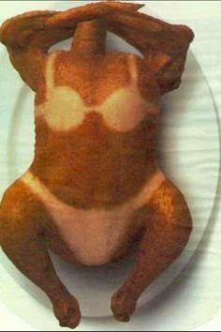
CAC@Kerckhoff
Friday, 10/31, 10:00 AM - 12 noon
Friday, 11/07, 11:30 AM - 1:30 PM
Friday, 11/14, 9:30 AM - 12:30 PM
Friday, 11/21, NONE
Friday, 11/27, NONE
for reserved interviews, during the above hours or other times, e-mail me
or Assistant CAC Tristan Darvin at asscac@apo-x.org

Slide 65
AM Budget Proposal
We will run through each position
Each position will have the floor until we choose to move on
At the end, we will vote to approve the budget as a whole

